Slide 1
Vocabulary for
MEANING IN CONTEXT

Slide 2
ˌtop-ˈnotch adjective informal something that is top-notch is of the highest quality or standard :
- I was lucky and got myself a job with a top-notch company.

Slide 3
put in phrasal verb put in something to do something in a particular way, especially a performance in a play, film, race etc :
- He put in a brilliant performance in the British Grand Prix.

Slide 4
shelter / ˈʃeltə / noun bus shelter British English a small structure with a roof where you wait for a bus

Slide 5
downpour / ˈdaʊnpɔː / noun a lot of rain that falls in a short time

Slide 6
bite noun a bite (to eat) informal a small meal :
- We had a bite to eat and a couple of drinks before the flight.

Slide 7
squeeze / skwiːz / verb to try to make something fit into a space that is too small, or to try to get into such a space SYN squash squeeze into
- Five of us squeezed into the back seat. squeeze somebody/something in
- We could probably squeeze in a few more people.

Slide 8
crash noun a sudden loud noise made by something falling, breaking etc :
- I heard a loud crash . with a crash
- The branch came down with a crash. crash of
- a crash of thunder

Slide 9
brace noun something that is used to strengthen or support something, or to make it stiff :
- The miners used special braces to keep the walls from collapsing.
- She had to wear a brace after the accident.

Slide 10
rust / rʌst / noun the reddish-brown substance that forms on iron or steel when it gets wet
- There were large patches of rust on the car. rusty / ˈrʌsti / adjective metal that is rusty is covered in rust:
- a rusty nail
- a new metal that will never go rusty

Slide 11
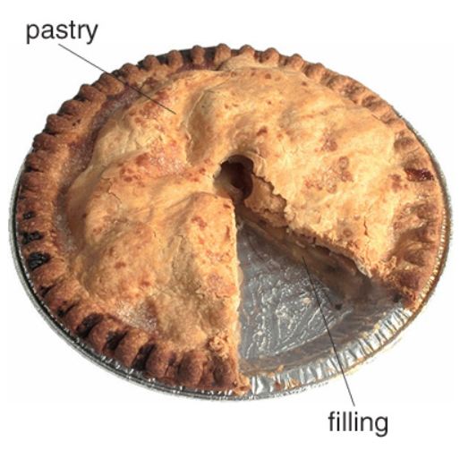
pastry / ˈpeɪstri / noun a small sweet cake, made using pastry :
- a Danish pastry

Slide 12
agenda / əˈdʒendə / noun a list of the subjects to be discussed at a meeting :
- the next item (= subject ) on the agenda

Slide 13
stroll / strəʊl verb to walk somewhere in a slow relaxed way stroll down/over/along
- We were strolling along, laughing and joking. stroll noun
They went for a stroll in the park.

Slide 14
White
Jerry
Ted
Lydia
Ben

Slide 15
THANK YOU

